Slide 1
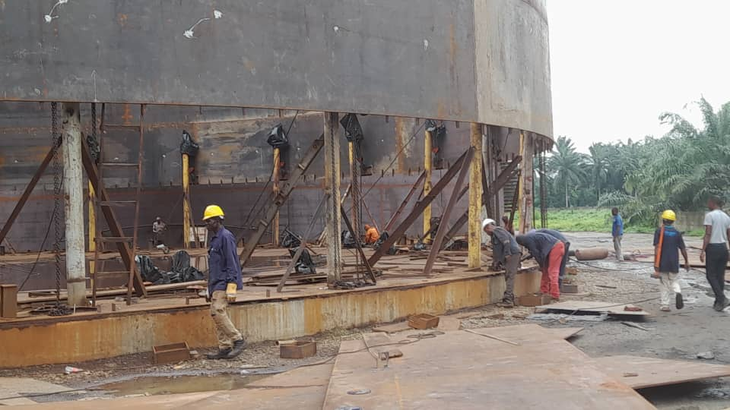
THE BENEFITS OF USING ELECTRIC HOIST FOR TANK JACKING/LIFTING COMPARED TO OTHER FORMS (By Industrial and Petroleum Engineering Services Limited) https://ipes-nigeria.com

Slide 2
TABLE OF CONTENT
(I) THE PROS AND CONS OF USING HYDRAULLIC JACK
(II) THE PROS AND CONS OF USING MONKEY JACK
(III) THE PROS AND CONS OF USING CRANE
(IV) THE PROS AND CONS OF USING ELECTRIC HOIST

Slide 3
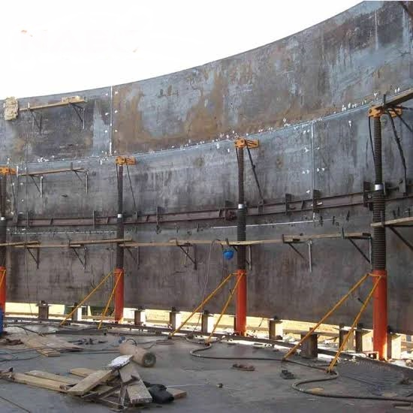
PROS AND CONS OF USING HYDRAULLIC JACKS

Slide 4
PROS AND CONS OF USING HYDRAULLIC JACKS
THE PROS OF USING HYDRAULLIC JACKS ARE:
(I) IT IS SAFE TO USE, SINCE ERECTORS DO NOT HAVE TO STAY ON BRACKETS WELDED TO TANK SHELLS.
(II) THE USE OF ELECTRIC POWER IS NOT REQUIRED.
(III) IT JACKS/LIFTS TANKS SAFELY BASED ON OPERATOR’S CONTROL.

Slide 5
PROS AND CONS OF USING HYDRAULLIC JACKS
THE CONS OF USING HYDRAULLIC JACKS ARE:
(I) SOMETIMES THE HYDRAULLIC OIL LEAKS, THEREBY MAKING JACKING DIFFICULT AND REPAIRS CAN DELAY JACKING OPERATIONS.
(II) JACKING/LIFTING CAN BE SLOW SOMETIMES
(III) IT CAN BE RELATIVELY EXPENSIVE TO OTHER FORMS LIFTING

Slide 6
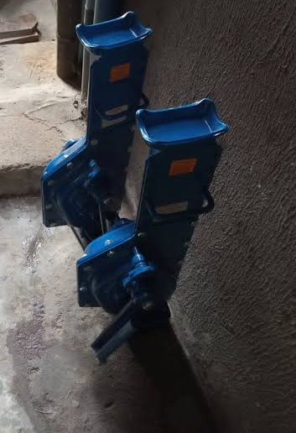
THE PROS AND CONS OF USING MECHANICAL JACK (MONKEY JACK )

Slide 7
THE PROS AND CONS OF USING MONKEY JACK
PROS:
(I) THE JACK IS USED FOR MAINTENANCE PURPOSE, NOT FOR TANK ERECTING OPERATIONS.
(II) IT IS COST EFFECTIVE FOR MAINTENACE WORK THAT INVOLVES MANUAL TANK LIFTING/JACKING.
CONS:
(I) IT CAN NOT BE USED FOR TANK SHELL ERECTING OPERATIONS
(II) IT CAN NOT JACK MORE THANK TWO(2) FEET

Slide 8
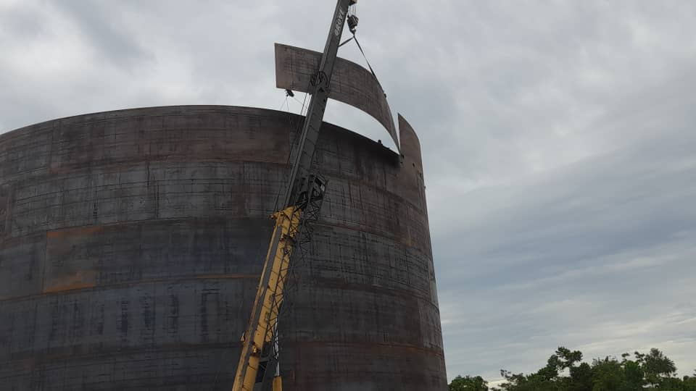
PROS AND CONS OF USING CRANE FOR TANK ERECTION

Slide 9
THE PROS AND CONS OF USING CRANE FOR TANK JACKING/LIFTING
PROS:
(I) IT CAN LIFT TANK SHELL TO ANY HEIGHT
(II) IT CAN BE FAST
(III) IT CAN NAVIGATE TIGHT TERRAIN FOR SHELL PLATE LIFTING
CONS:
(I) STRONG WINDS AT HEIGHT CAN CAUSE ACCIDENT FOR ERECTORS
(II) IT CAN BE EXPENSIVE TO HIRE DEPENDING ON THE TERRAIN
(III) SLIPS AND FALL OF ERECTORS FROM HEIGHT

Slide 10
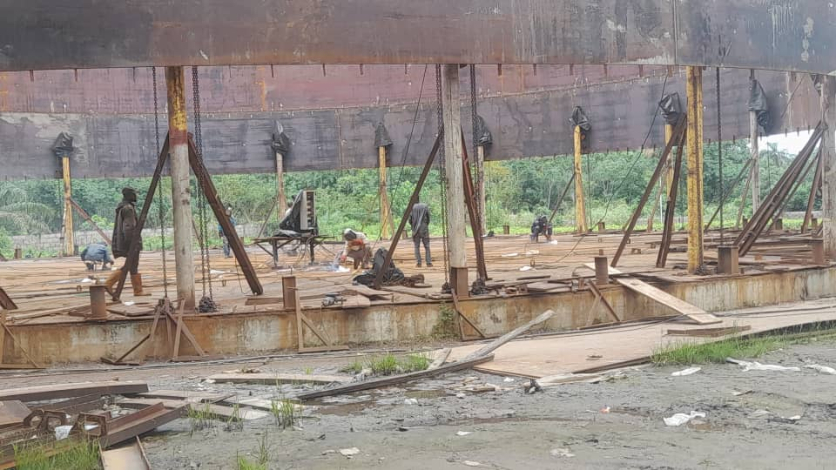
PROS AND CONS OF USING ELECTRIC HOIST FOR TANK LIFTING/JACKING

Slide 11
PROS AND CONS OF USING ELECTRIC HOIST FOR TANK LIFTING/JACKING
PROS:
THE SPEED OF LIFTING CAN BE VARIED WITH THIS SYSTEM
IT IS THE FASTEST MEANS OF ERECTING TANKS
CONS:
ONE OF THE ELECTRIC HOIST CAN GET FAULTY DURING OPERATIONS WARRANTING CHANGE (WE HAVE SUFFICIENT PARTS AVAILABLE)
CLICK LINK TO THE ELECTRIC HOIST DEMO VIDEO (ipes-nigeria.com/img/services/tr1.mp4)
CLICK LINK TO THE PRACTICAL APPLICATION TO TANK LIFTING (ipes-nigeria.com/img/services/tr2.mp4)

